Slide 1


SENTIMENT ANALYSIS
- Darshil Panchal
31031421012

Slide 2

Introduction of dataset
Sentiment analysis, also referred to as opinion mining, is an approach to natural language processing (NLP) that identifies the emotional tone behind a body of text. This is a popular way for organizations to determine and categorize opinions about a product, service or idea.
The domain of the dataset is based on the SMS is smart phone.
This dataset does not contain any missing values and has both negative and positive comments which helps in sentiment analysis.

Slide 3
Problem Statement
Sentiment Analysis is performed to this dataset to check accuracy of the positive and negative.
By doing this, these will help the people to recognize non-urgent or say spam messages
This will help the day to day essential time.
The messages on smart phones are analysed and further classified into spam and ham(means not spam)

Slide 4
Techniques used in the dataset
Importing libraries(numpy, pandas, nltk).
Text-preprocessing includes removing punctuations and stop words, implementing lemmatization and performing POS tagging.
To get the appropriate accuracy we have used following model: Logistic Regression.
Logistic Regression: It is used calculate or predict the probability of a binary event occurring.

Slide 5
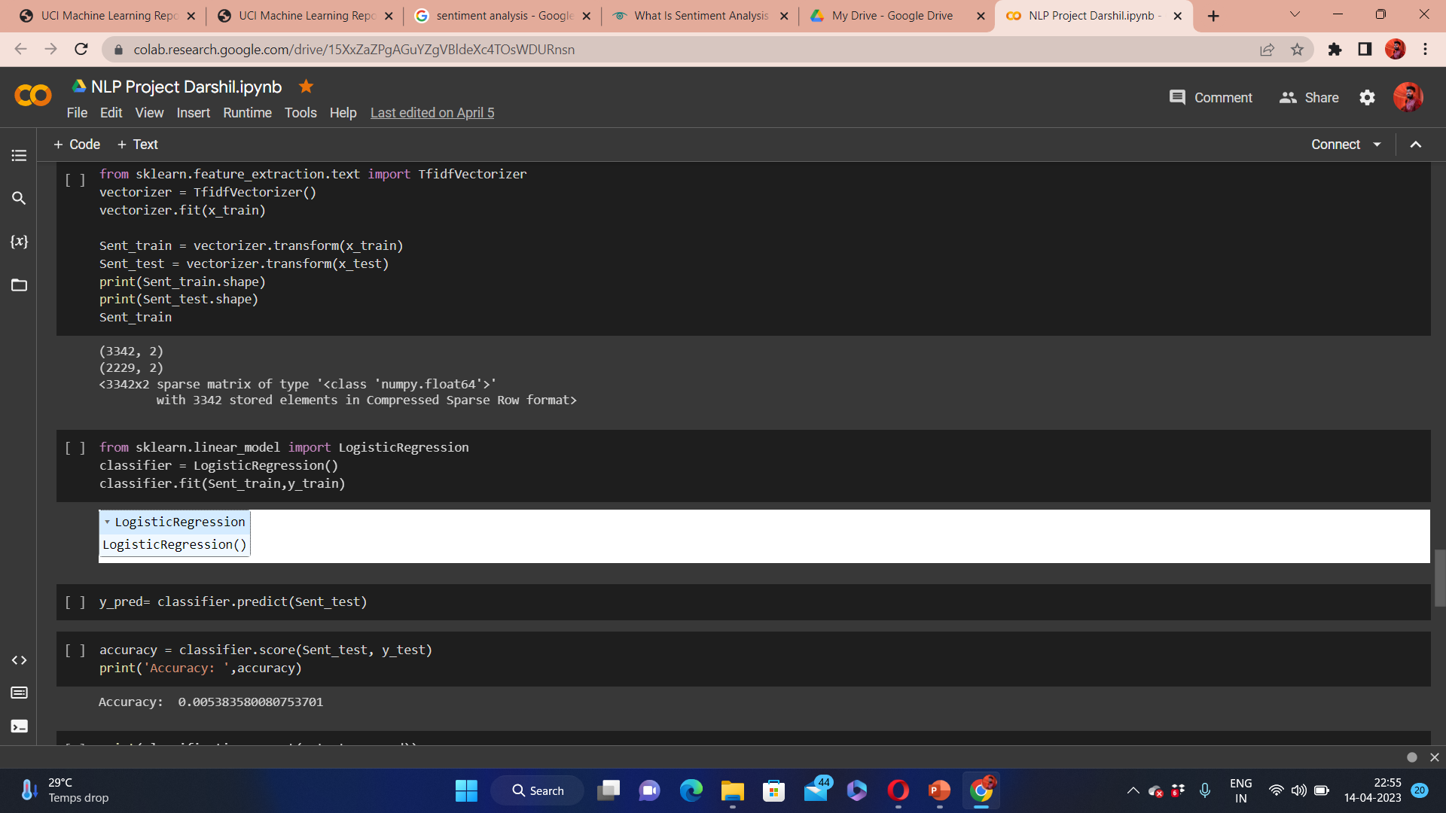
Accuracy

Slide 6
Conclusion
By applying Logistic Regression model the appropriate accuracy is proven sometime,
The accuracy value of model satisfactory
By this we can conclude that Logistic Regression model gives average accurate value for doing sentiment analysis of spam and not spam message.

Slide 7
Thank You

